Slide 1
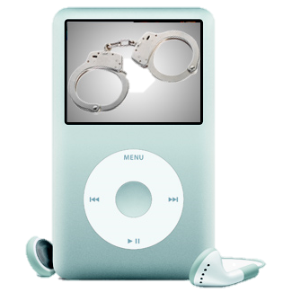
You, Your Computer, & The Law

Slide 2
Copyrights
Copyright Laws
Protects people that created content (musicians, writers, painters, software creators, etc…)
Have been around for a long time
Digital Millennium Copyright Act
Adjusted copyright laws to specifically address how technology impacts copyrighted material
States when you can and cannot legally copy information using computers

Slide 4
Software License
A legal contract that defines the ways you may use a computer program.
Includes: buying, selling, copying, & renting.
Each piece of software comes with its own specialized license but many of the basics are the same
The “I Agree” statement that you click on when installing new software.

Slide 5
Types of Software Licenses
Traditional License – limited to 1 copy on 1 computer, cannot copy, sell, or alter program
Windows, Video Games, Anti-Virus Software
Shareware - “try before you buy” policy. 30 Days of use before it becomes inactive or starts bugging you to purchase
Adobe Acrobat Professional, Winzip, Easy Movie Splitter
Freeware – Created and owned by someone who is giving it to you for free.
Chrome, Firefox, Picasa
Public Domain Software - owned by the public. Freely copied, distributed, and resold.
Weblab

Slide 6
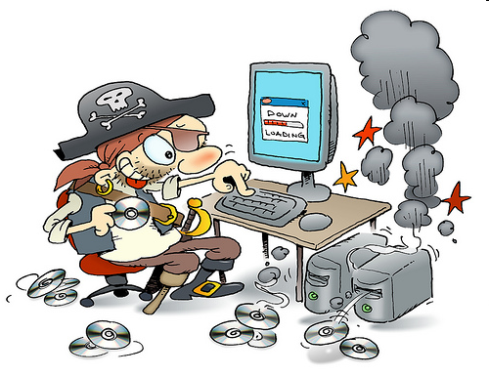
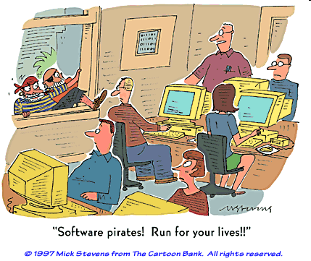
Software Pirates
People who illegally copy, distribute, or modify software.
Profit or nonprofit
May be distributed through copied disks and/or the Internet

Slide 7
What you are legally allowed to do
Copy software (movies & music) you own for backup purposes
Make a compilation of music you already own (aka playlists, favorites CD)
Copy a TV program so that you may watch it later in the comfort of your own home

Slide 8
What you are legally not allowed to do
Copy rented or borrowed material (software, music, or movies)
Rent out products you own to make money
Share/swap copies of your product collection with friends
Make copies of your products and sell either the originals or the copies
Knowingly purchase or freely receive copies of music, movies, or software
Download music, movies, or software off of the internet for free that are copyrighted and should have been purchased through other means

Slide 9
Class Activity
Identify if the activity is:
Legal (Thumbs Up)
Illegal (Thumbs Down)

Slide 10
You just recorded yourself singing a song you wrote and now are going to post it on YouTube.
Legal

Slide 11
You just recorded yourself singing a the popular song Royals by Lorde and now are going to post it on YouTube.
Illegal

Slide 12
You borrow a movie from a friend to make a copy of it to put on your iPad for vacation.
Illegal

Slide 13
You purchase a movie from Best Buy and then you make a copy of it to put on your iPad for vacation.
Legal

Slide 14
You download a piece of Public Domain Software and you then sell copies of it for $10.
Legal

Slide 15
You download a piece of Freeware and you then sell copies of it for $10.
Illegal

Slide 16
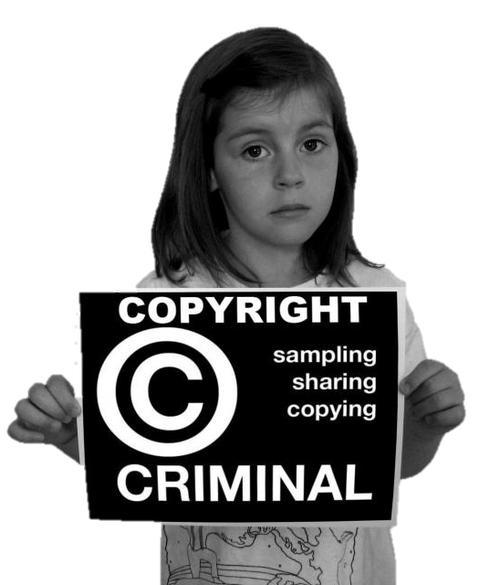
Penalties – Federal Crime
Individuals
Up to 5 years in Prison
$750 to $150,000 fines per downloaded song

