Slide 1
Web Languages
What Is a Web Page?
Notes:
What is a web page? What happens when you load a web page?

Slide 2
The Web Is Part of the Internet
TCP/IP connects computers to create the Internet.
All computers on the Internet have an IP address, e.g. 140.80.12.60. This address is used as the "To:" and "From:" address in TCP/IP.
Some computers on the Internet are web servers, answering requests using the HTTP protocol.
Notes:
Protocols can sit one on top of another. After a handshake, there are more protocols that let a conversation build to a more and more meaningful exchange.

Slide 3
Acronyms
Protocols
TCP = Transmission Control Protocol
IP = Internet Protocol
HTTP = Hypertext Transfer Protocol
Languages
HTML = Hypertext Markup Language
CSS = Cascading Style Sheet
Notes:
Recite the acronyms and their full names out loud. Doing so creates new neural connections in your brain devoted to saying and thinking these phrases.

Slide 4
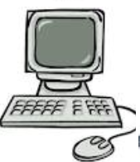
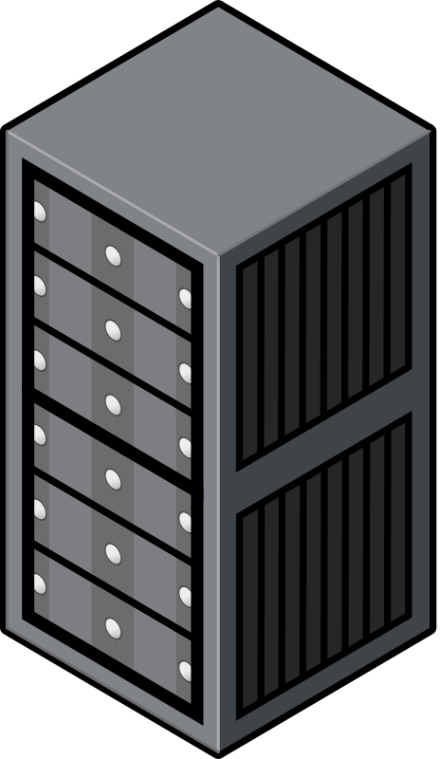
The Web Uses Client-Server Architecture
Clients
All computers have an IP address
Many clients can initiate two-way communication
Common clients: Firefox, Chrome, Safari
Server All servers have an IP address. e.g., pltw.org → 190.93.241.249
Server holds data and web content
Common web server program: Apache
Notes:
All Internet communication is end-to-end: two computers, having a two-way conversation. For the web, one of the computers is the client, and the other is the server. The client is a browser application like Safari, Internet Explorer, Firefox, or Chrome. You type in a URL that contains a domain name, and your client application gets the IP address for the server using the Domain Name System – a group of computers that keep track of the IP address for every domain name. Then your client sends packet to that IP address by opening a connection to the server and asking for the web page.
NOTE: More information about this is on slide #5.

Slide 5
The Web Uses Protocols
IP Header
TCP Header
HTTP Header
HTML Header
HTML Body
HTTP Body
TCP Body
IP Body
Notes:
Computers communicate using protocols. Protocols determine what some of the 0s and 1s mean in a message.
This picture shows the protocols we will address in this lesson. Each protocol specifies a header– certain 0s and 1s with specific meaning. Each protocol has a body where the computer can send additional data. IP and TCP work together to carry a wide variety of payloads, including HTTP.
IP addresses the packets. TCP numbers the packets and makes sure that missing packets or packets with errors can be identified. HTTP says “I want this web page.” The details are not so important – unless you’re the one who worries about that level of abstraction.

Slide 6
Web Content Is HMTL, CSS, JavaScript…
HTML: Marks up meaning of content
CSS: Stylizes the content
JavaScript: Makes the content interactive
<HTML>
<HEAD>
<TITLE>Great web page</TITLE>
</HEAD>
<BODY>
Some great content
</BODY>
</HTML>
Notes:
The server responds with data, usually text written in these three languages: HTML, CSS, and JavaScript. Of course, the data also include the words and multimedia that appear on the web page.
But the web content has to get from one machine to another. Any two computers on the Internet can exchange packets with each other. The protocols that let them do that can carry web data or any other data.

Slide 7
HMTL: Elements Marked with Tags
<HTML>
<HEAD>
<TITLE>Great web page</TITLE>
</HEAD>
<BODY>
Some great content
<IMG SRC="beauty.jpg">
</BODY>
</HTML>
Notes:
Tags are inside the angle brackets. <HTML> is a tag that starts the HTML element. </HTML> is a tag that ends that elements. Elements can be nested inside other elements. Some elements have only one tag, like the IMG element.

Slide 8
HMTL Elements with Attribute=Value Pairs
<HTML>
<HEAD>
<TITLE>Great web page</TITLE>
</HEAD>
<BODY>
Some great content
<IMG SRC="beauty.jpg">
</BODY>
</HTML>
Notes:
Most tags can have attributes that describe the element. Attributes are listed inside the tag with a value. This image (IMG) element has a source (SRC) attribute. The value of the source attribute is the string "beauty.jpg", and it tells the browser where to find the image. This value says the browser should ask the server for the file beauty.jpg in the same directory that the HTML came from.

Slide 9
CSS: Styling a Page
<HTML>
<HEAD>
<TITLE>Great web page</TITLE>
</HEAD>
<BODY style="color: #FF00FF">
Some great content
<IMG SRC="beauty.jpg">
</BODY>
</HTML>
Notes:
CSS is another language used along with HTML. The CSS can be included in the HTML here, although best practice is to keep it in a separate document so that a single style can be applied to many documents. CSS has properties and values. In this example, the HTML body element is being selected for a particular style. The style property is the color. The value of the color is magenta: red and blue are set at 255 (FF) in hexadecimal, while green is 0.
Note: "Attribute" and "property" are very similar in meaning. In HTML, the difference is that an attribute is hardcoded in the HTML, while a document property is initialized to the same value as the HTML attribute but the value of the property might be changed by JavaScript acting on the document.

Slide 10
Learning More
W3C is the authority
http://www.w3.org/
W3Schools and many other organizations have learning resources
http://www.w3schools.com/
Notes:
There is a lot of information on the web about HTML, CSS, and JavaScript. It is easy to find conflicting or outdated information. For a decade, each browser invented its own "standards," creating much confusion. For this reason, it is important to know the authoritative source: W3C, the world wide web consortium, not to be confused with W3schools. W3C is a consortium of companies that maintain the standards for HTML, CSS, and the JavaScript libraries that are included in HTML5. JavaScript is a full computer programming language; only the HTML5 libraries of JavaScript for web documents are maintained by W3C; the core of the language is maintained by another organization, ECMA.

