Slide 1
PC Hardware
What is your Personal Computer made of

Slide 2
Computer:
A Device that:
Accepts information
Processes information
Stores information
Produces information
Only 1 item in front of you is a Computer! Do you know which item that is?
All of the components combined are considered to be the Computer System

Slide 3
Other Devices that are Computers (But we don’t call them such)
Game Consoles
Xbox, Nintendo, Playstation, etc….
Calculators
Cell Phones
GPS Devices
TiVo / DVR Boxes
MP3/MP4 players
Ipod, zune, sansa
E-Book Readers
Kindle, Nook
Other Crazy Computers

Slide 4
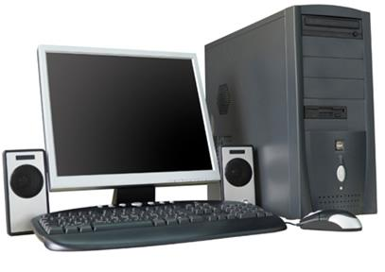
Form factors of a PC 1. Desktop
a personal computer small enough to fit conveniently in an individual workspace
Pros:
Most powerful/fastest PCs
Most bang for your buck performance
Separate components for easy upgrade/change
Lots of storage
Lots of peripherals available
Lots of screen real estate
Gaming
Cons:
Not portable

Slide 5
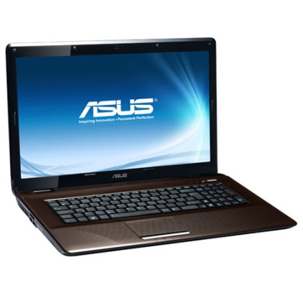
Form factors of a PC 2. Laptop
a personal computer that is portable and suitable for use while traveling
Pros:
Portable
Low power consumption
Battery powered
All in one design
Cons:
Slow Performance
Small Screen
Not very upgradable
Difficult to fix components
Poor Ergonomics
Too hot to put on your lap
Battery life
Theft

Slide 6
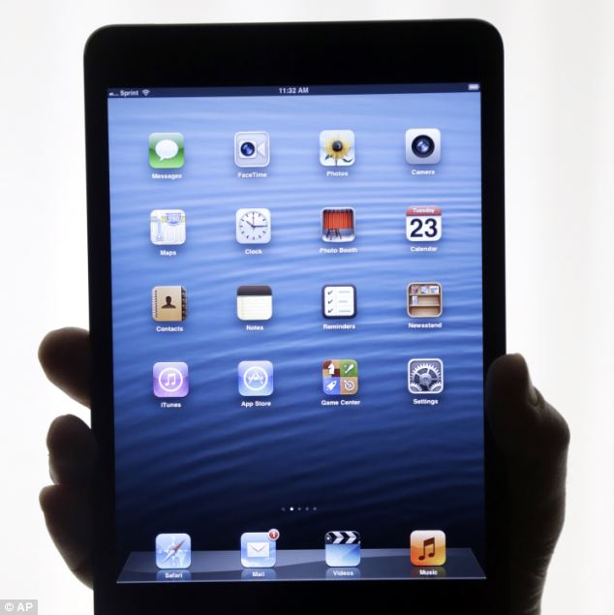
Form factors of a PC 3. Tablet
is a one-piece mobile computer. Devices typically have a touchscreen, with finger or stylus gestures replacing the conventional computer mouse.
Pros:
Very Portable
Very Low power consumption
Battery powered
Long battery life
Quick to turn on and access
Cons:
Expensive
Slower than laptops
Small Smudgy Exposed Screens
No physical keyboard
Specialized software
Designed more for consumption than production
Not upgradable
Theft

Slide 7
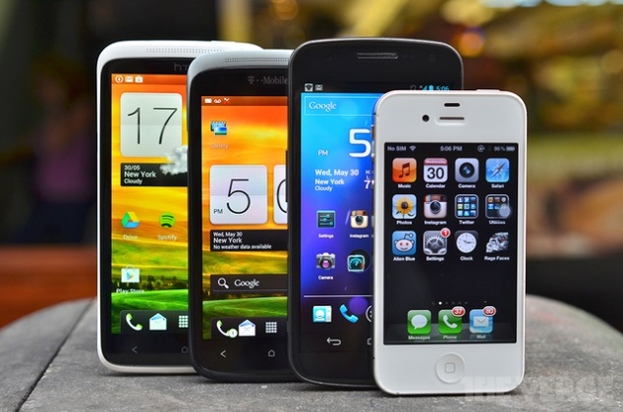
Form factors of a PC 4. Smartphone
a cellular phone that is able to perform many of the functions of a computer, typically having a relatively large screen and an operating system capable of running general-purpose applications
Pros:
Super Portable
Also phones
Always Connected
Very Low power consumption
Battery powered
Cons:
Poor Web Experience
Least processing power
Very Small Screen
Specialized software
Designed more for consumption than production
Not upgradable
Theft (1 of 3 reported robberies)
High environmental impact
Very Expensive

Slide 8
What is Hardware?
Hardware
The electronic and mechanical devices that make up the computer
Aka: all the physical parts
Think Hard = touchable
Includes all the internal components and the peripheral devices

Slide 9
Internal Hardware
Motherboard
is the main printed circuit board (PCB) found in computers and other expandable systems. It holds many of the crucial electronic components of the system, such as the central processing unit (CPU) and memory, and provides connectors for other peripherals.
Processor
It is a multipurpose, programmable device that accepts digital data as input, processes it according to instructions stored in its memory, and provides results as output.
Faster = better

Slide 10
Internal Hardware
Graphics Card
a printed circuit board that controls the output to a display screen.
Faster = Better
RAM Memory
A form of fast short term data storage
More = better

Slide 11
Internal Hardware
Hard drive
is a data storage device used for storing and retrieving digital information using rapidly rotating disks (platters) coated with magnetic material.
more and or faster = better
Storage
Floppy Disk / CD / DVD / Blu-Ray

Slide 12
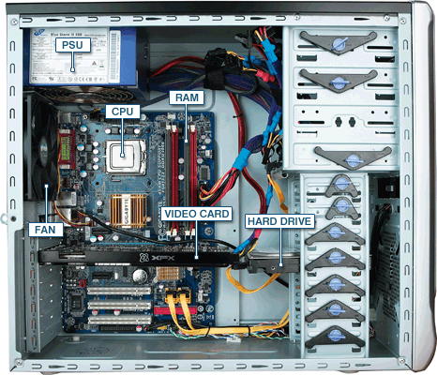
Internal Desktop Hardware

Slide 13
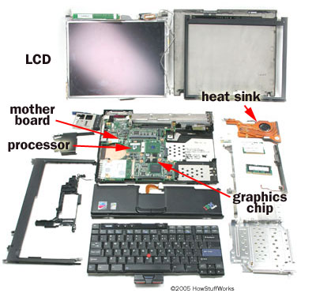
Internal Laptop Hardware

Slide 14
Peripheral Devices
Peripheral = surrounding
Computer hardware that expands the computer’s input, output, and storage capabilities
Connects to the actual computer tower to perform task

Slide 15
Input Peripheral Devices
Hardware used to gather and translate information into a form that the computer can process
Takes info from us and puts it into the computer
Ex: Mouse, Keyboard, etc…

Slide 16
Output Peripheral Device
Hardware that displays, prints, or transmits the results of processing from the computer memory
Takes information from the computer and sends it back out to us in a form we can understand
Ex: Monitor, Printer, etc…

Slide 17
Storage Peripheral Device
Hardware that stores information/data for later use
Ex: External Hard Drive, USB Thumb Drive, etc…

Slide 18
What do you need to put together a basic computer system?
Tower/CPU – The actual computer in your system where all processing occurs
Monitor – The display device that shows you the info from your computer
Types: CRT, LCD, Projector
Importance: Size, Speed, Speakers
Keyboard – Primary input device you type on
Wireless, multi-media, shortcut buttons

Slide 19
Basic Computer System Parts
Mouse – secondary input device that you use to manipulate objects on the screen
Trackball, optical, scroll wheel, wireless, extra buttons
Printer – allows you to get work to paper
Inkjet, laser, color, photo quality, CD/DVD printing, speed, multifunction

Slide 20
Additional Hardware Components you may want to add
USB Jump Drive
USB Hub
Game Controllers
Scanners
External Hard Drives
Speakers
Web Cam
Digital Camera
Memory Card Reader
Multiple Monitors
MP3 player

Slide 21
Original Computers (not PCs)

Slide 22
1951 – The MIT created Whirlwind Computer
This computer help MIT become the prominent ivy league school that it is today
Size: Filled 4 rooms of a two story building
Cost: $708,900 to build in 1951
$5,961,281 in today’s currency

Slide 23
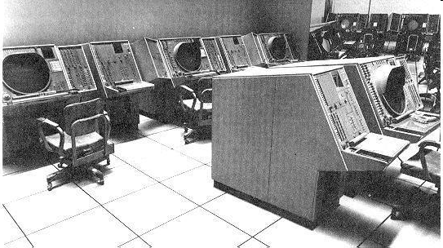
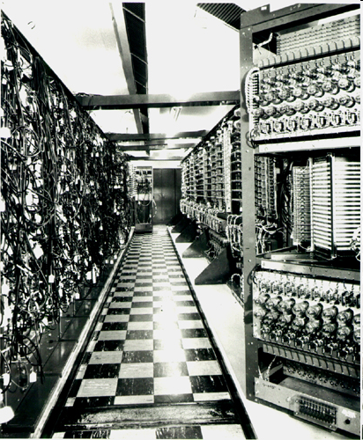
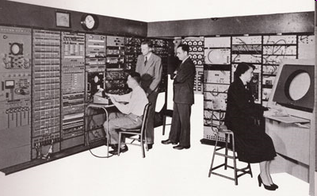

Slide 24
1951 – The Remington Rand build Univac 1
The first computer to ever have a video game designed for
Simple to complex math pitting the user against the computer
Size: Weighed in at 13 tons (26000 lbs) the equivalent of 13 elephants or 6.5 Volkswagen Beetles
Cost: $750,000 then = $6,306,900 today
Printer Cost: $185,000 then = $1,555,702 today

Slide 25
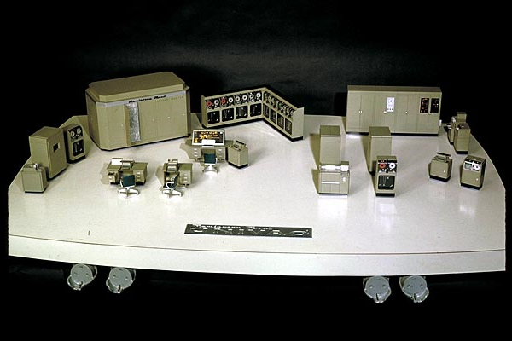
Smithsonian scale model of the Univac 1

Slide 26
1958 – IBM build the An/FSQ-7 Computer
Largest computer ever built
Installed in a specially designed 4 story building to hold it
Took up more than 2000 square meters
That is equal to half a football field
Weighed 275 tons
That is equal to 133 Ford Mustang Cars
Took 60 employees working 24/7 to keep the computer functional

Slide 27
